Slide 1
Unlocking Stock Performance Insights
Radjamin Hukom
1/16/2025

Slide 2


Overview
Problem:
making educated decisions to invest is time-consuming and complex.
Proposed Solution:
Develop a data-driven framework to invest
This Photo by Unknown Author is licensed under CC BY-SA

Slide 3


Project Idea
Objective:
Identify key determinant financial ratios
Create a robust model to use for investment
Problem Solved:
Simplify investment analysis
This Photo by Unknown Author is licensed under CC BY-NC-ND
This Photo by Unknown Author is licensed under CC BY

Slide 4
Project plan
Gather Data
Explore and Clean the Data
Run the Models
Examine Problems
Attempt to Fix Problems

Slide 5

Dataset
Data Collection
Finsheet.io: Extracts financial statements, ratios, and key metrics.
Bloomberg: Provides real-time stock data and historical financial trends.
Programming & Tools
Google Colab (Python): Used for data preprocessing, model training, and visualization
Key Features:
S&P500 stocks + 1000 stocks from Russel 3000 index

Slide 6
On the Data
Rows = 1509 stock tickers
Columns = Ticker + Beta + 12 financial ratios * 5 years + % Price Change = 63
Problems:
Missing values
Outliers
Multicollinearity
Heteroscedasticity

Slide 7
Financial Ratios
Ratio | Meaning | E(sign)
Beta | Indicates the stock’s risk relative to the market | -
EPS | Shows profitability per share | +
ROE | Measures how efficiently equity generates profit | +
ROA | Reflects how effectively assets generate profit | +
Gross Margin | Reveals profitability after production costs | +
Operating Margin | Indicates how well operations generate profit before interest and taxes. | +
Net Profit Margin | Shows overall profitability after all expenses | +
Cash Ratio | Assesses short-term liquidity | +
Current Ratio | Measures short-term financial health | +
Quick Ratio | Evaluates liquidity without relying on inventory | +
Asset Turnover | Shows how efficiently assets generate revenue | +
Inventory Turnover | Reflects how quickly inventory is sold | +
Receivables Turnover | Measures how fast credit sales are collected | +

Slide 8
Machine learning models
Multiple Linear Regression (MLR): Establishes baseline relationships between variables.
Ridge & Lasso Regression: Enhances model stability by regularizing coefficients.
Elastic Net Regression (ENR): Balances Ridge and Lasso benefits for correlated predictors.
Support Vector Regression (SVR): Captures complex non-linear stock trends.
Random Forest Regression (RFR): Uses ensemble learning to improve accuracy.
Decision Tree Regression (DTR): Simple but prone to overfitting.
K-Nearest Neighbors Regression (KNNR): Predicts based on similar stock behaviors.
Weighted Least Squares (WLS) Regression: Handles heteroscedasticity in financial data.
Logit: Predicts positive or negative changes over 5-year period.

Slide 9
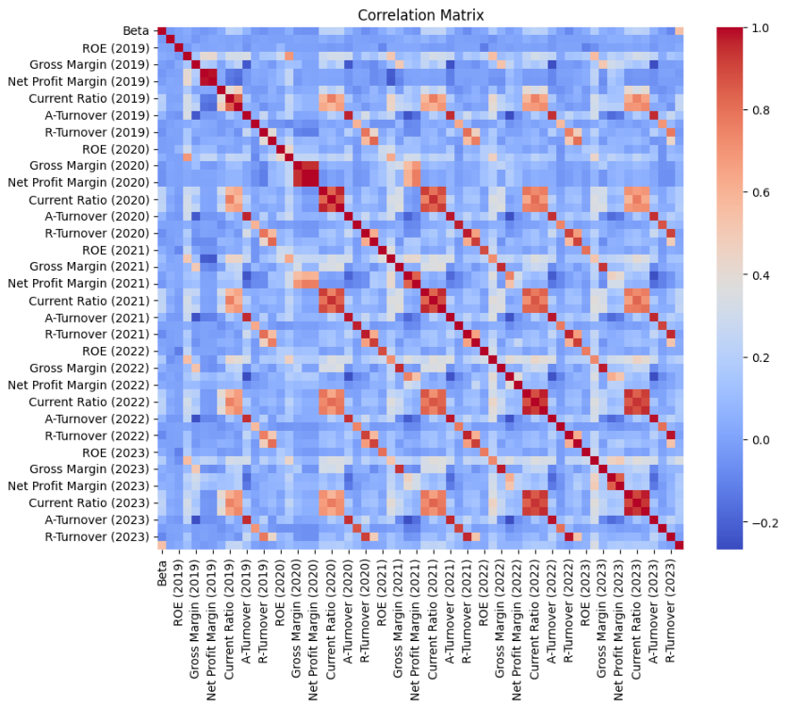
Important point:
There’s similar patterns over the years

Slide 10
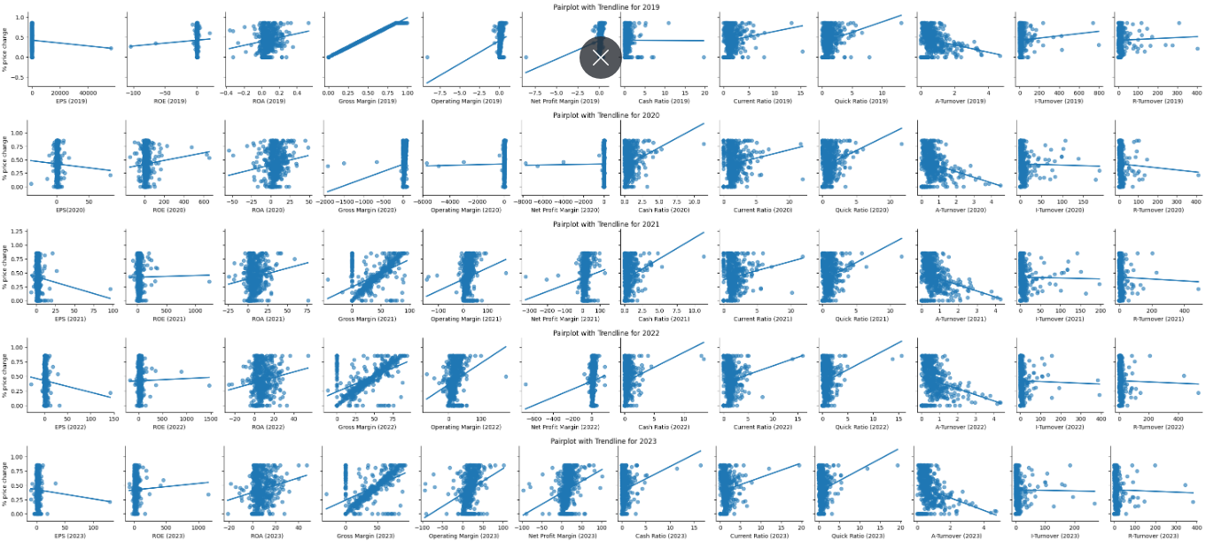

Slide 11
Ratios and % Price Change (Correlation)
Year | Ratio
2019 | Gross Margin***, Operating Margin, Net Profit Margin, Quick Ratio
2020 | Gross Margin**, Cash Ratio
2021 | Gross Margin**, Cash Ratio, Quick Ratio
2022 | Gross Margin**, Operating Margin
2023 | Gross Margin**, Operating Margin, Net Profit Margin

Slide 12
Ratios and % Price Change (Regression)
Year | <.05 | <.1
2019 | Gross Margin, Cash Ratio
2020 | ROA, Gross Margin, Current Ratio, Quick Ratio, A-Turnover | EPS, Net Profit Margin
2021 | Gross Margin Current Ratio, A-Turnover | EPS, Quick Ratio
2022 | Gross Margin, Operating Margin, Current Ratio, A-Turnover
2023 | Gross Margin, Operating Margin, Current Ratio, A-Turnover

Slide 13
Comparison of models
Models | Adjusted R-squared
Multiple Linear Regression | 1
Ridge Regression | .9990
Decision Tree Regression | 0.9989
Weighted Least Squares Regression | 1
Random Forest | 0.9992
Logit | .9663
Lasso | -0.0089
Elastic Net | -0.0089
SVR | -0.0090

Slide 14
Years Ranked by Adjusted R^2
2019: 0.996220
2022: 0.367828
2023: 0.350413
2021: 0.331874
2020: 0.241247

Slide 15

Initial Conclusions
Key takeaways:
2019 is by far the most accurate year to predict the 5-year stock price change
Focus on:
MLR (for baseline)
WLS (for heteroscedasticity)
Ridge (for multicollinearity)

Slide 16
NEW Variables
New Variables | Formula | Variance Inflation Factor
EPS | EPS | 1.001612
Gross Margin | Gross Margin | 1.030736
Returns | (ROA + ROE) /2 | 1.001706
Liquidity | (Cash + Quick + Current) Ratio /3 | 1.024700
Efficiency | (Asset + Inventory + Receivables) Turnover /3 | 1.005129

Slide 17
Is it robust? No!
Multicollinearity (intercorrelation among explanatory variables) is not like present.
Breusch-Pagan test for 2019:
P-value: 4.915320339106688e-106
White test for 2019:
P-value: 1.7970621043702633e-93
Heteroscedasticity (the variability of the response variable is unequal among the explanatory variables) is likely present.
Durbin-Watson statistic for 2019: 2.009556556490634 Autocorrelation (degree of correlation of response variable over time) is not likely present.

Slide 18
More data
Added 1000 more data samples
Multicollinearity stayed even after combining variables now

Slide 19

After trial & Error
Replace columns with the WLS-adjusted columns from the WLS model
Remove 'beta','EPS (2019)’
Test for BLuE
Check explanatory power

Slide 20
Robust, promising results
VIF values
Breusch-Pagan test for heteroscedasticity: P-value: 0.9466911602113062 No evidence of heteroscedasticity
Durbin-Watson test for autocorrelation: Durbin-Watson statistic: 2.000022615417361 No evidence of autocorrelation
Adjusted R-squared: 0.9999999999991485
Variables | VIF
Gross Margin (2019) | 1.136221
Returns (2019) | 1.017909
Liquidity (2019) | 1.132923
Efficiency (2019) | 1.041528

Slide 21
For the future
Check mix of stock tickers used (ensure there’s a fair amount of large, medium, and small companies)
Use more data (as we still only have ~1500 stock tickers)

Slide 22
Work cited
Bloomberg. (n.d.). Company profiles. Bloomberg. Retrieved from https://www.bloomberg.com
Finsheet. (n.d.). Financial data analysis tools. Finsheet. Retrieved from https://www.finsheet.io

